Slide 1
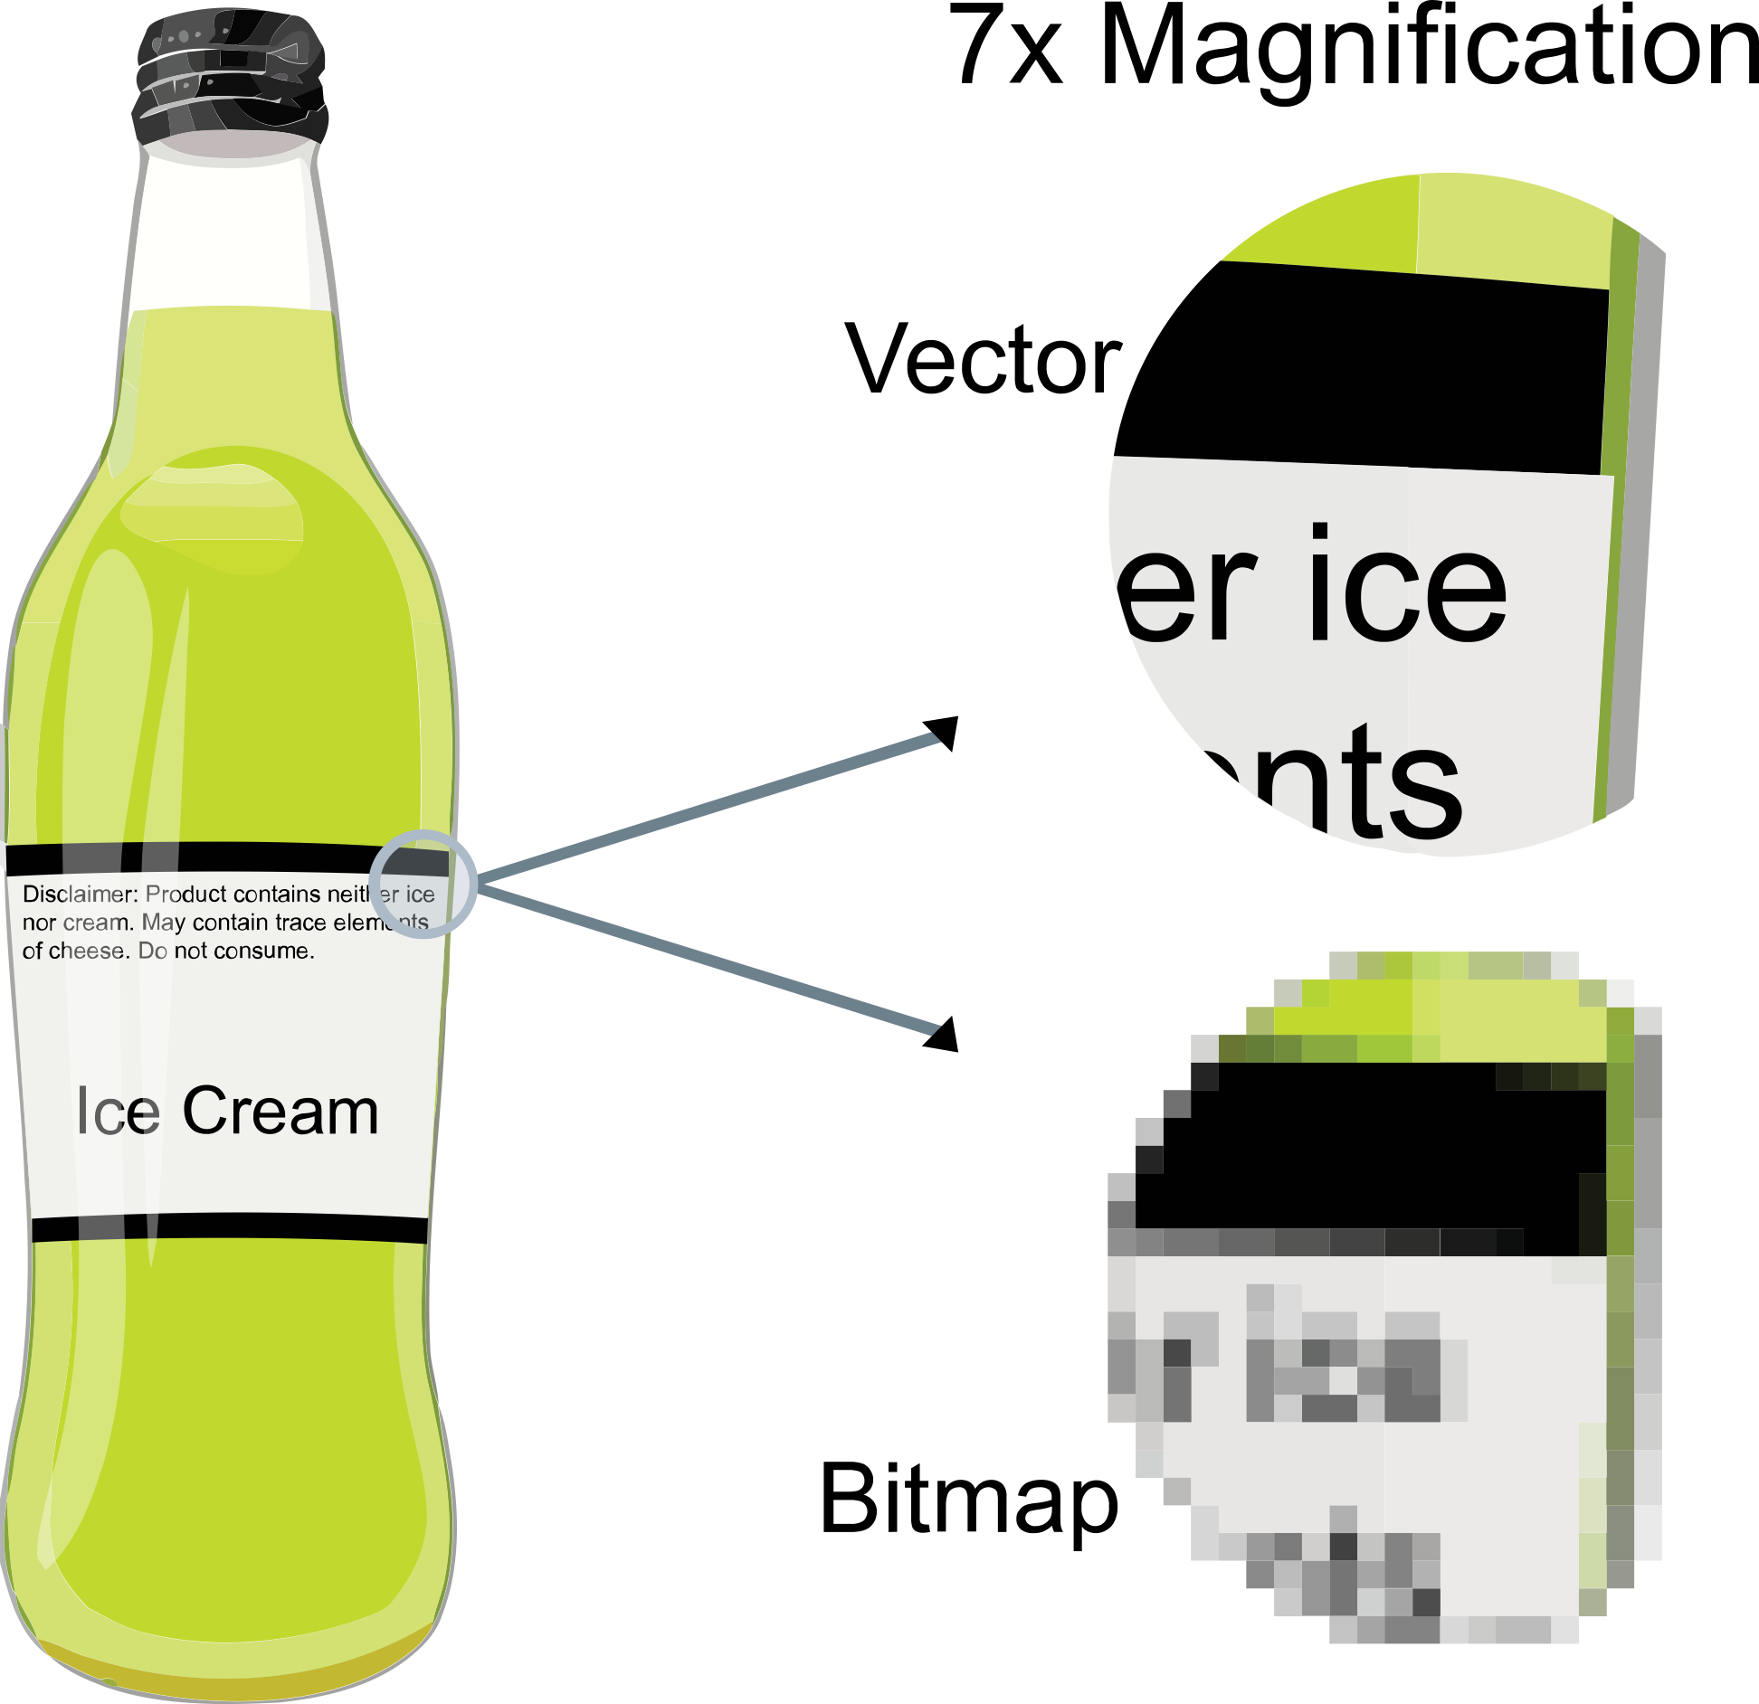
Vectorized Images
Common vectors: .pdf, .svg, .eps
Common rasters:
.jpg, .png, .gif

Slide 2
Open:
Komodo_Dragon.png Komodo_Dragon.pdf

